Slide 1
Data-Rich Research

Slide 2

Professor of Mathematics + Atmosphere/ Ocean Science, NYU
PhD, Earth + Planetary Sciences, Harvard
Expertise
  Large-scale climate dynamics
  Ocean Turbulence
  Uncertainty quantification
Synergistic activities
  Lead Principal Investigator, NSF-NOAA Climate Process Team on Ocean Eddy Parameterizations, 2019-
  Member, Ocean Model Development Panel, International CLIVAR, 2019-
  Steering Committee, FAFMIP (Flux-anomaly-forced model intercomparison project, part of CMIP6), 2019-

Slide 3

Assistant Professor of Computer Science, Columbia
PhD, Computer Science, MIT
Expertise
  Machine learning
  Computer vision
  Interpretable models
Synergistic activities
  Research Scientist, Google, 2017-2018
  Co-host of AI4All at Columbia for computer vision
  Best Paper Finalist, IEEE Conference on Computer Vision and Pattern Recognition, 2019

Slide 4

Our Roadmap
LEAP forward in the reliability, utility, and reach of climate projections through synergistic innovations in data science and climate science.

Slide 5
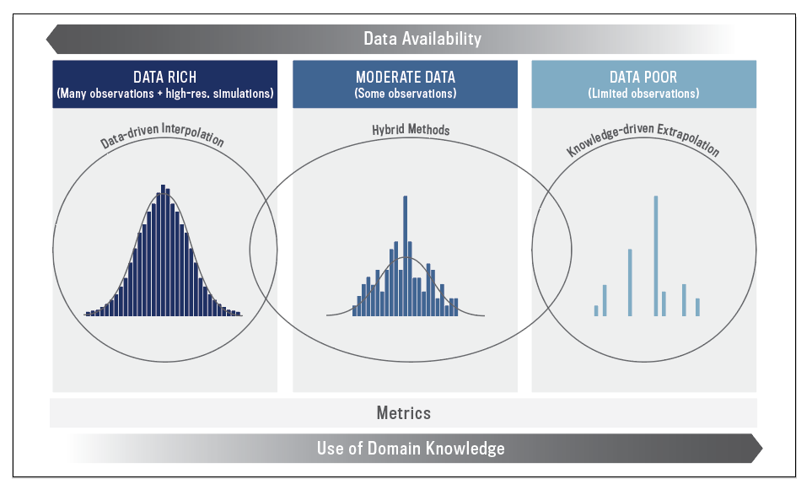
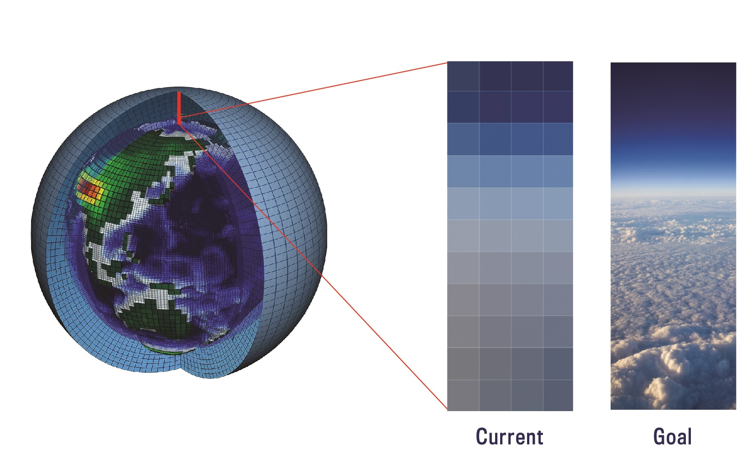
Next generation of parameterizations & metrics for climate simulations
Earth System Model
Data-driven parameterizations
Metrics: Datasets and approaches
refinements

Slide 6
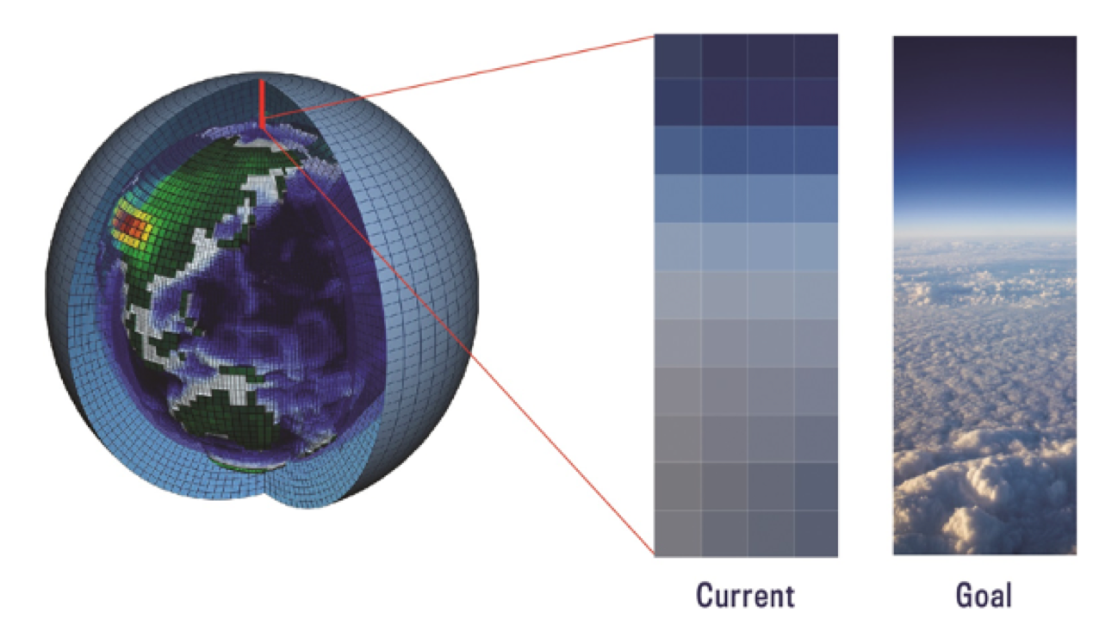
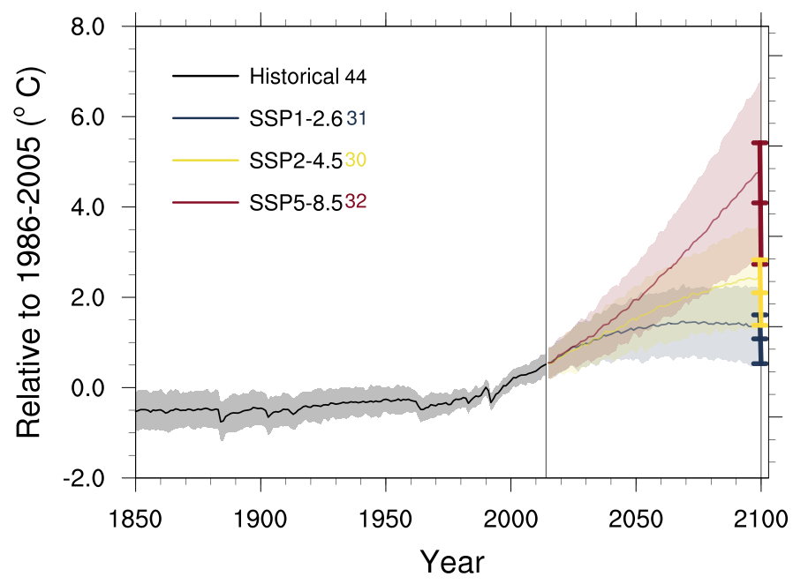
Uncertainty in projections due to limited computing resources
Global Air Temperature – CMIP6
Model Spread

Slide 7
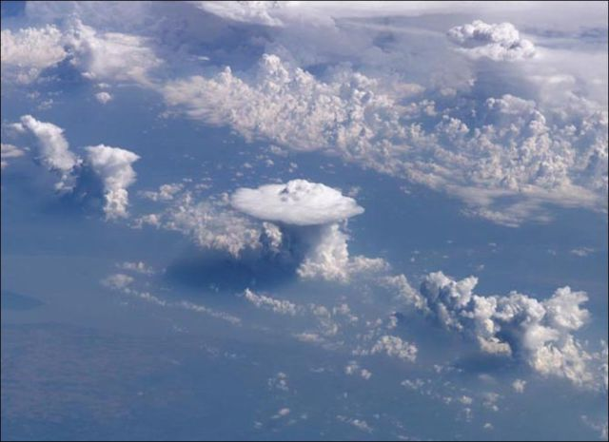
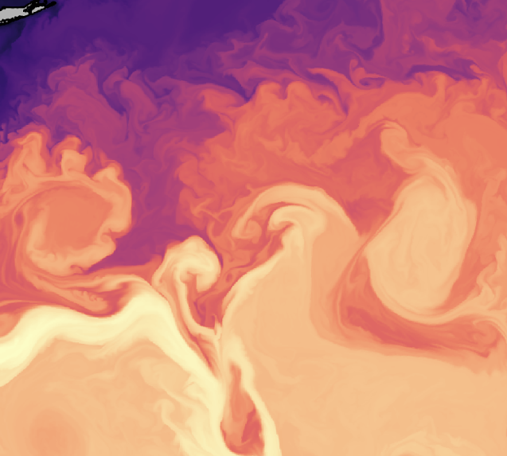
Parameterizations are rough approximations of missing physics
ESM Grid ~100km
ISS view
~100km

Slide 8
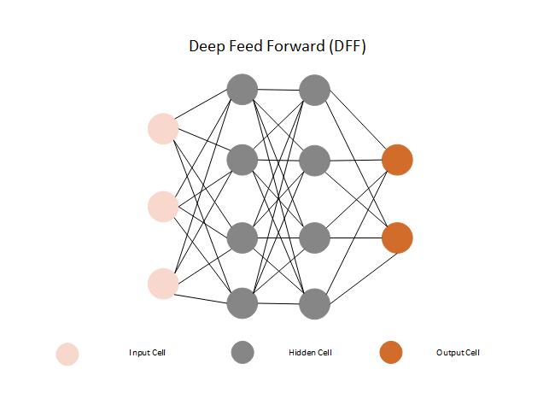
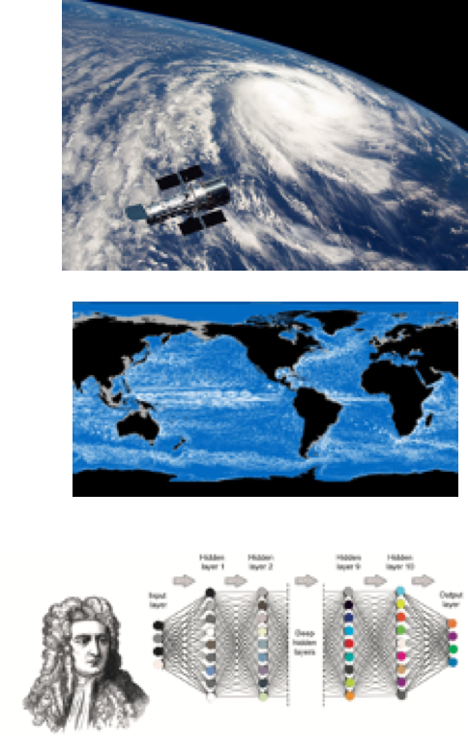



LEAP will integrate data science with domain-knowledge to create a new generation of ML parameterizations
Optimized ML algorithms
+
=
Physics constraints

Slide 9
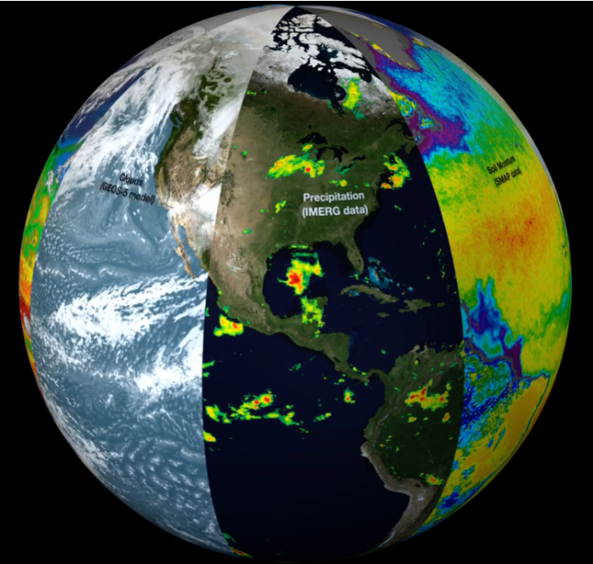

LEAP will integrate data science with domain-knowledge to create a new generation of ML parameterizations
Optimized ML algorithms
New generation of physics-guided parameterizations
~100km
+
=
ISS view
~100km
Physics constraints

Slide 10
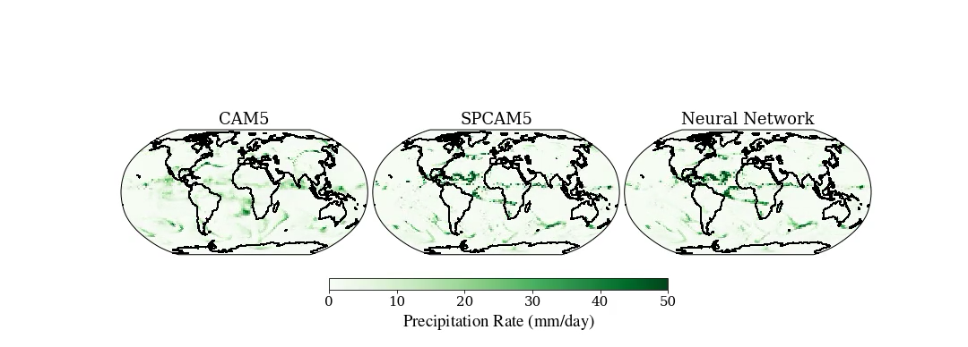
Proof-of-Concept #1: Convection parametrization
Atmospheric convection & clouds set regional + global temperatures, precipitations
~100km
ISS view
coarse-res + conventional parameterization
high-res
coarse-res + neural network parameterization
Gentine et al, GRL 2018; Rasp et al, PNAS 2019

Slide 11
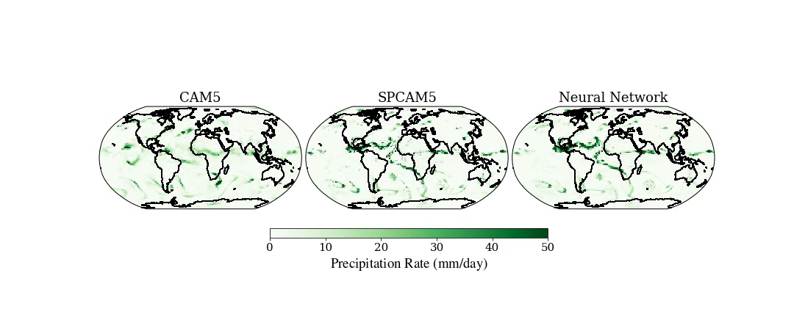
Proof-of-Concept #1: Convection parametrization
Atmospheric convection & clouds set regional + global temperatures, precipitations
~100km
+
=
ISS view
coarse-res + conventional parameterization
high-res
coarse-res + neural network parameterization
Gentine et al, GRL 2018; Rasp et al, PNAS 2019

Slide 12
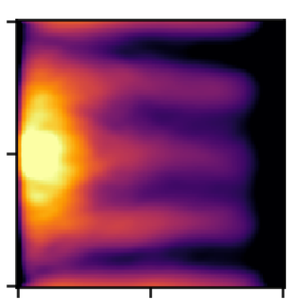
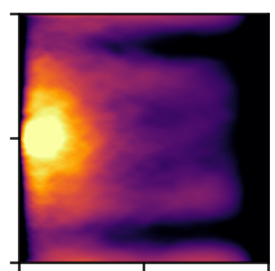
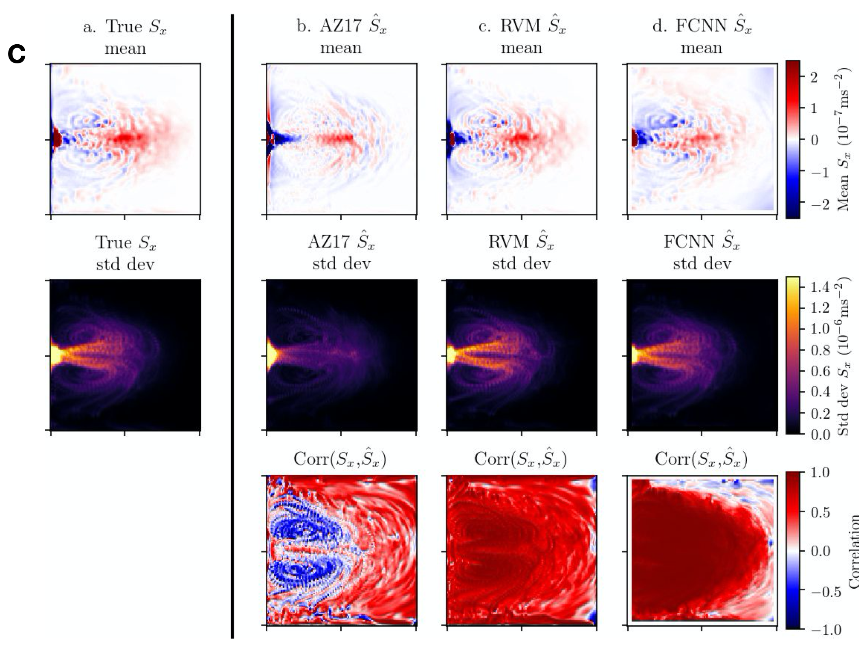
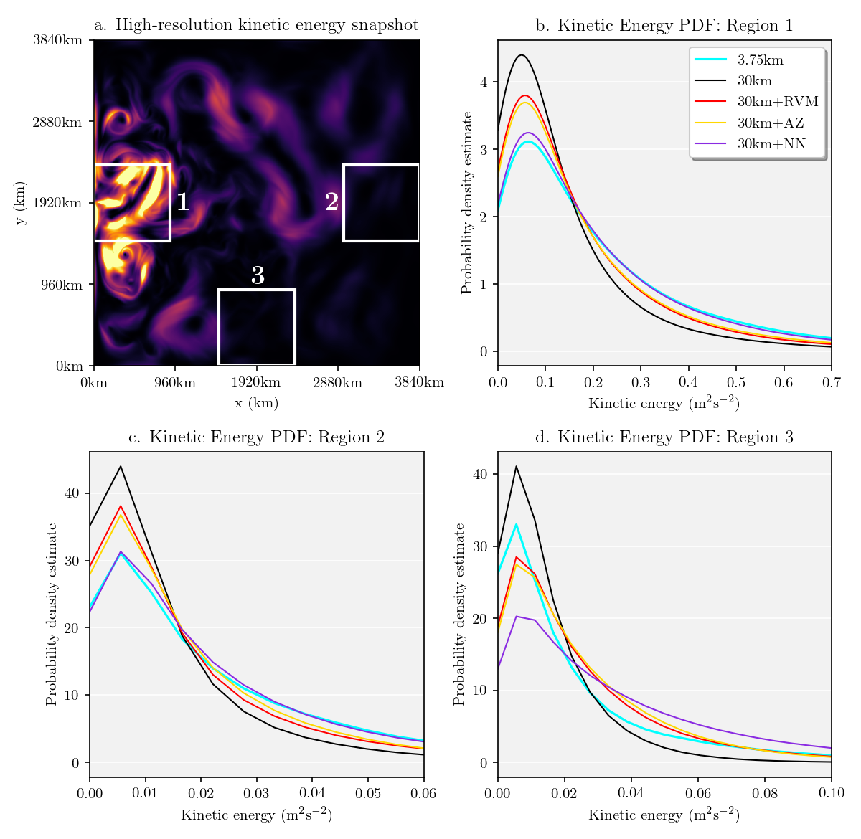
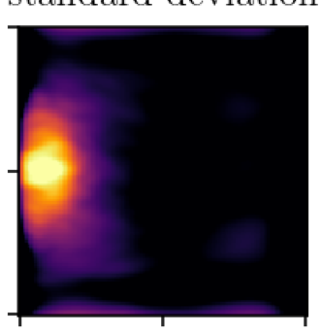
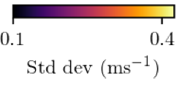
Proof-of-Concept #2: Ocean turbulence parameterization
Ocean eddies: turbulent features 10-100 km, crucial heat and carbon uptake, sea level
~100km
coarse-res + conventional parameterization
high-res
coarse-res + neural network
3840 km
2880 km
1920 km
y [km]
zonal velocity
960 km
0 km
9600 km
kms []km
0 km
1920 km
3840 km
0 km
1920 km
3840 km
0 km
1920 km
3840 km
x [km]
x [km]
x [km]
Bolton & Zanna, JAMES 2019; Zanna & Bolton, GRL 2020

Slide 13
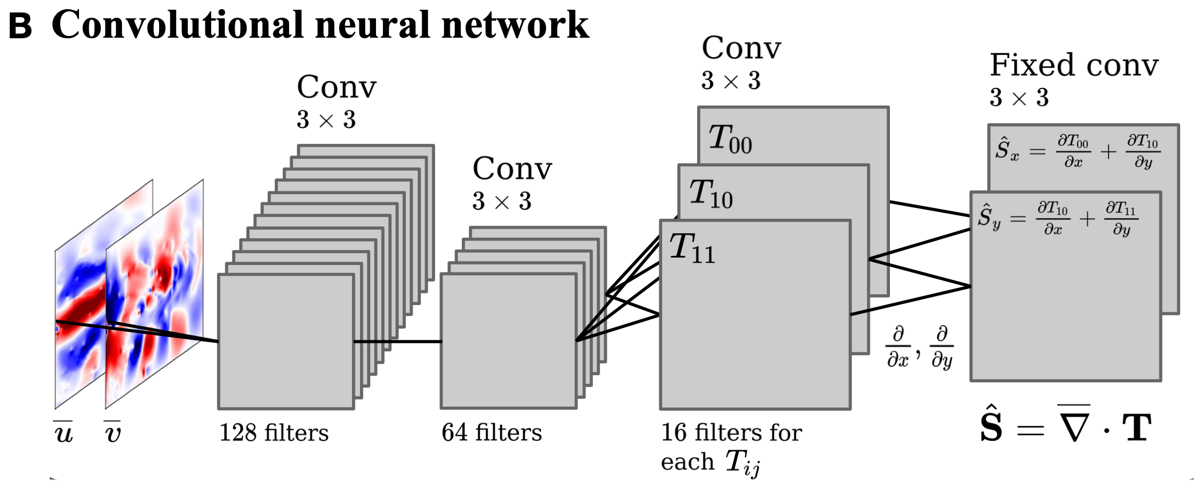
Proof-of-Concept #2: Ocean turbulence parameterization
Ocean eddies: turbulent features 10-100 km, crucial heat and carbon uptake, sea level
within the NN architecture
+
+
=
~100km
coarse-res + conventional parameterization
high-res
coarse-res + neural network
3840 km
2880 km
1920 km
y [km]
zonal velocity
960 km
0 km
9600 km
kms []km
0 km
1920 km
3840 km
0 km
1920 km
3840 km
0 km
1920 km
3840 km
x [km]
x [km]
x [km]
Bolton & Zanna, JAMES 2019; Zanna & Bolton, GRL 2020

Slide 14

LEAPing forward: Promise & Challenges
Exciting proof-of-concepts
Nexti-generation CESM
New algorithms
~100km
ISS view
~100km
Pushing ML forward:
Physics-guided/ generalization
Uncertainty quantification
Efficiency
Metrics

Slide 15
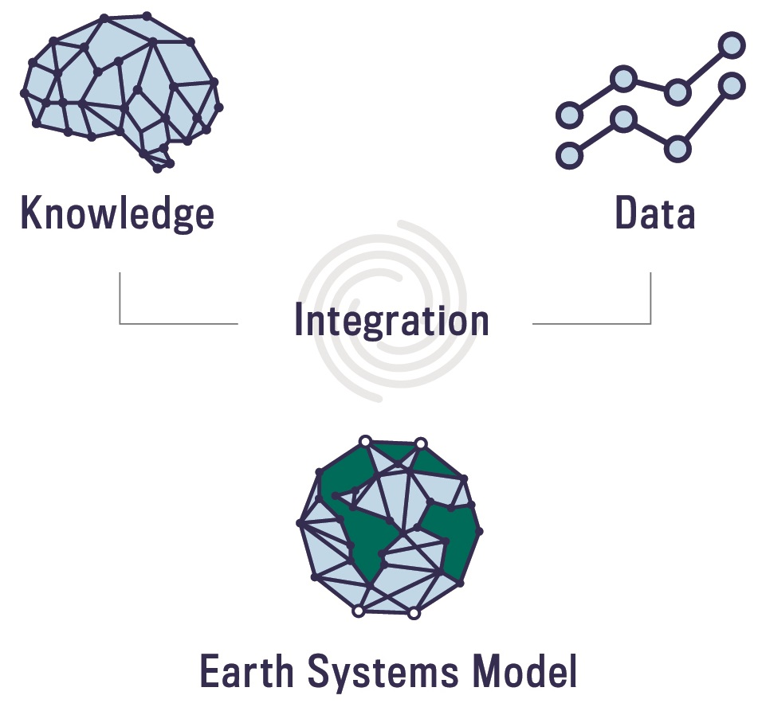
LEAP tackles four challenges in deep learning for climate science
Physical Reliability
Training Efficiency
Quantification of Uncertainty
Metrics

Slide 16
Physical constraints improve reliability and efficiency of machine learning models
Soft constraints
Hard constraints by construction
Embedded optimization problem inside network
Zanna and Bolton, GRL, 2020

Slide 17
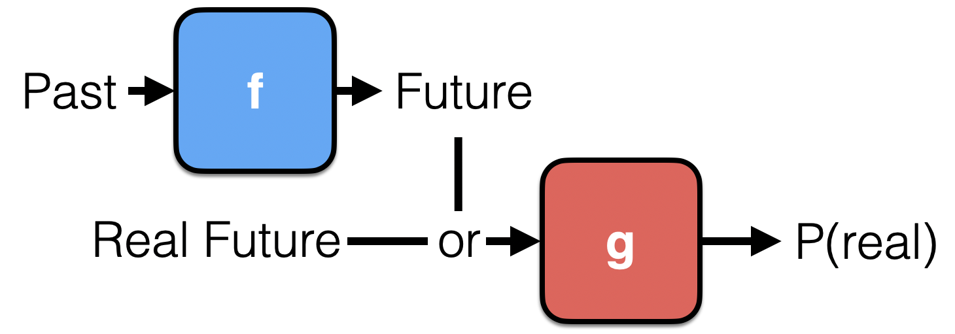
LEAP incorporates physics and data into metrics and loss functions
Higher order moments
Extreme values
Uncertainty estimates from simulation
Adversarial learning
Vondrick, Pirsiavash, Torralba. NeurIPS. 2016.

Slide 18
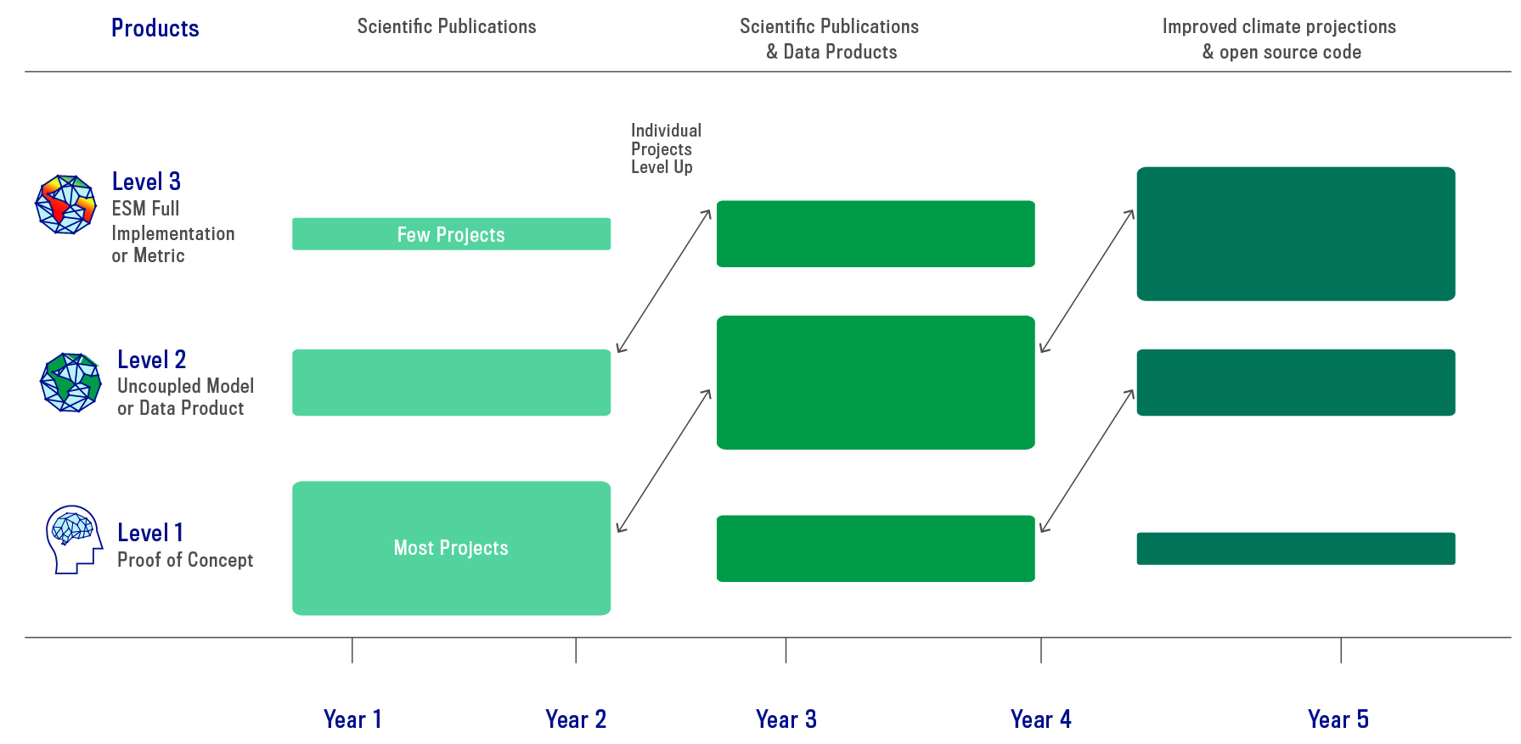
LEAP will progressively structure research to achieve impact on ESMs

Slide 19
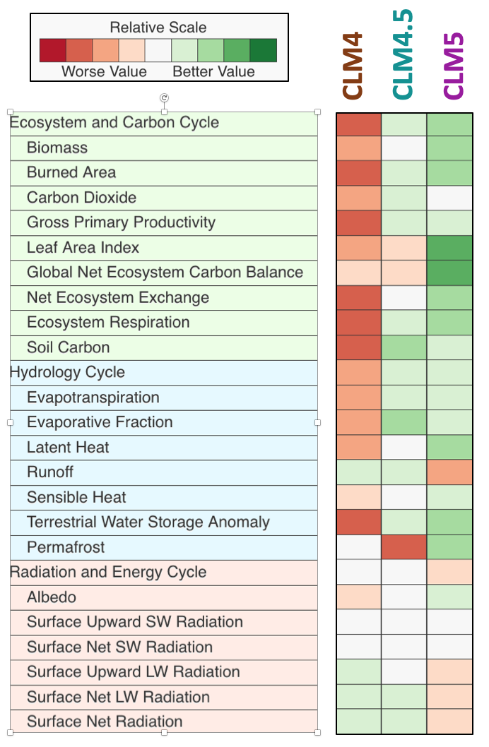
LEAP uses rich datasets, physical constraints, vetted metrics to improve parameterizations + climate simulations
Earth System Model
Metrics: Datasets and approaches
Data-driven parameterizations
refinements

Slide 20
Questions?
Dr. Laure Zanna, Professor at NYU
Dr. Carl Vondrick, Asst. Professor at Columbia
Research Co-Directors

